Slide 1





DreamNest

Slide 2




OUR TEAM
Khairul Islam
2020-1-60-109
Zahidul Islam
2020-1-60-260
MD. Farhad Billah
2020-2-60-213

Slide 3




INTRODUCTION
This is a house rent website. Where a user can rent a house and also can a user listed his property for rent. There are two sections on our website one for signed and another without
signed.

Slide 4


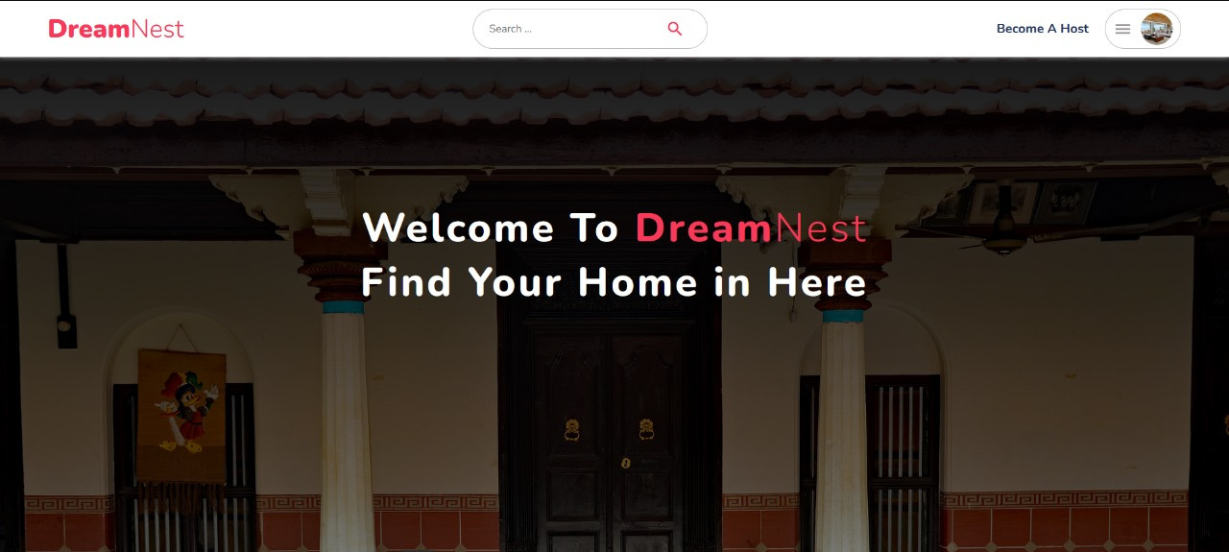

PROJECT OVERVIEW

Slide 5




PROCESS
01
Tools:
HTML
CSS
JAVASCRIPT
REACT
NODEJS
MONGOBD
02
Client
Server side

Slide 6

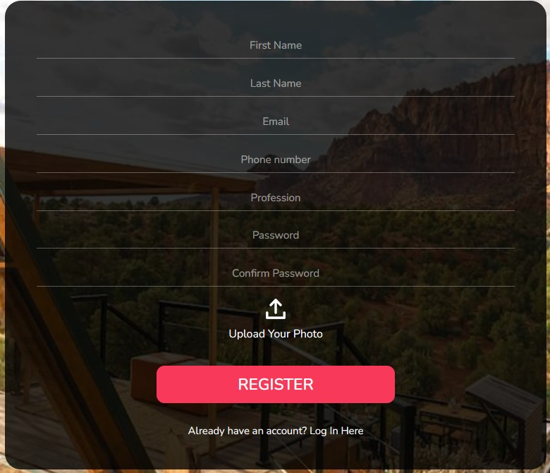
FUNCTIONALITY

Slide 7
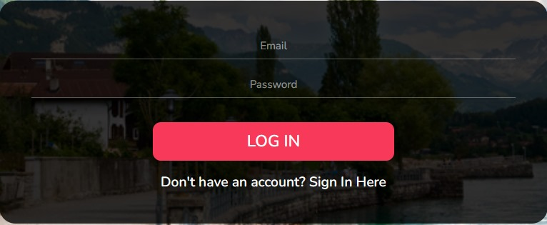
FUNCTIONALITY

Slide 8
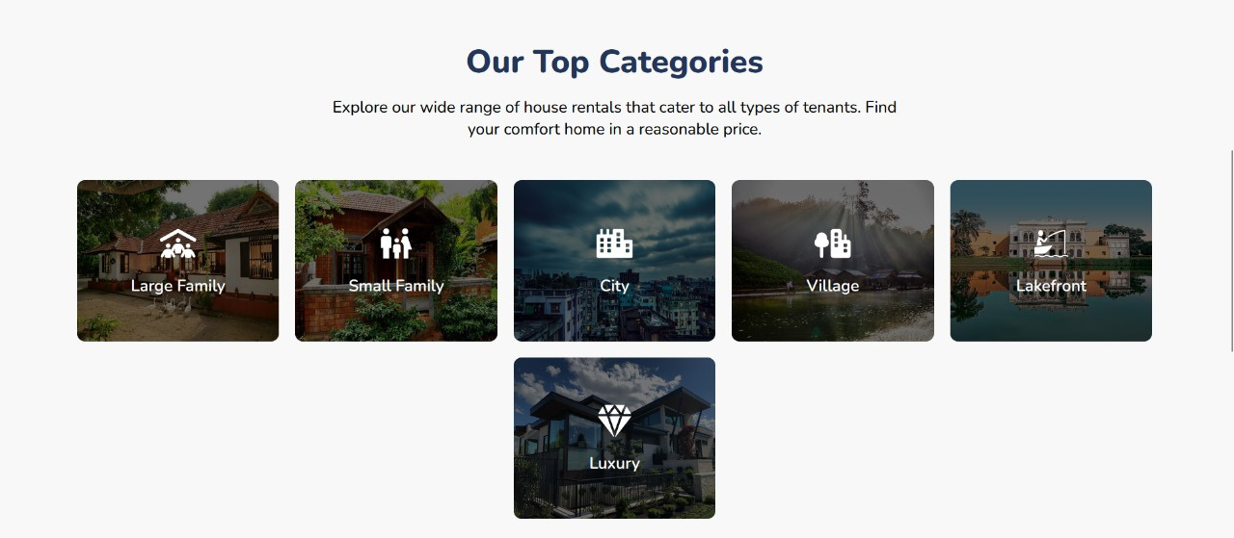
FUNCTIONALITY

Slide 9

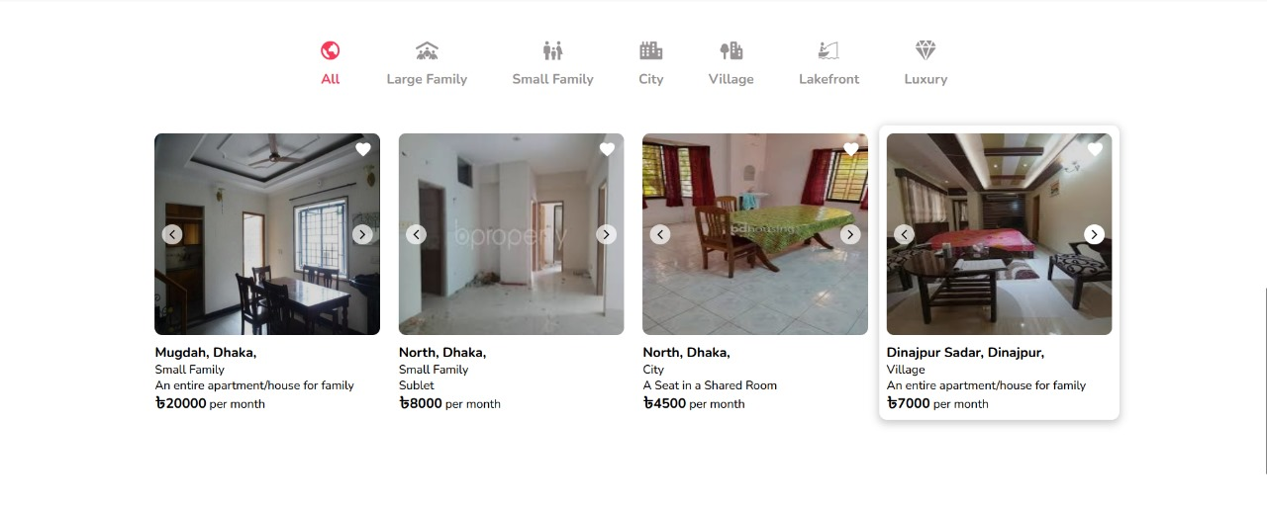
FUNCTIONALITY

Slide 10
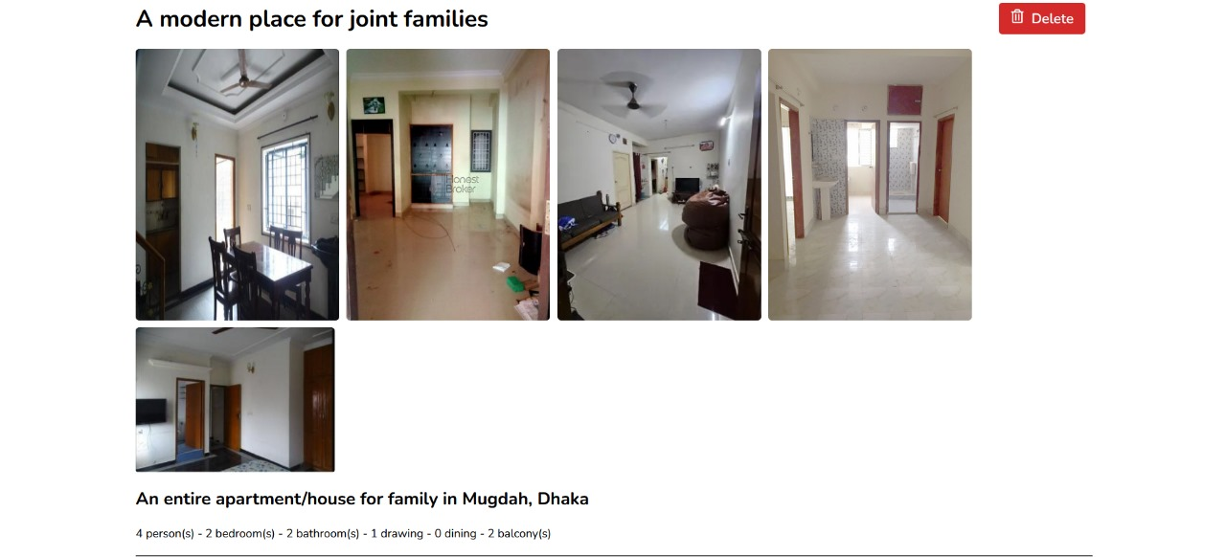
FUNCTIONALITY

Slide 11
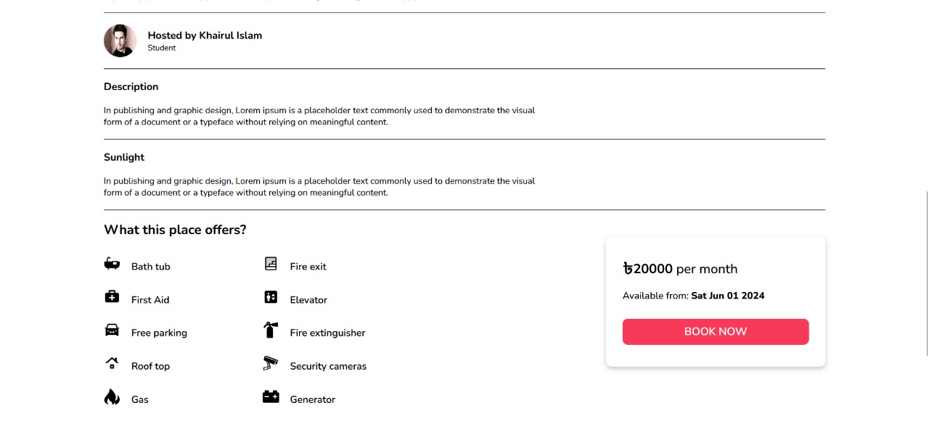
FUNCTIONALITY

Slide 12
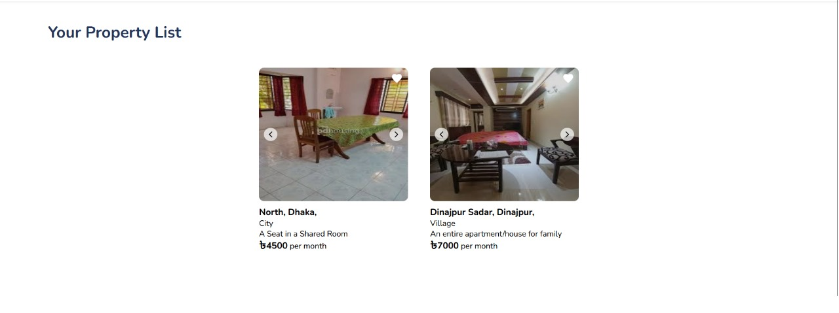
FUNCTIONALITY

Slide 13
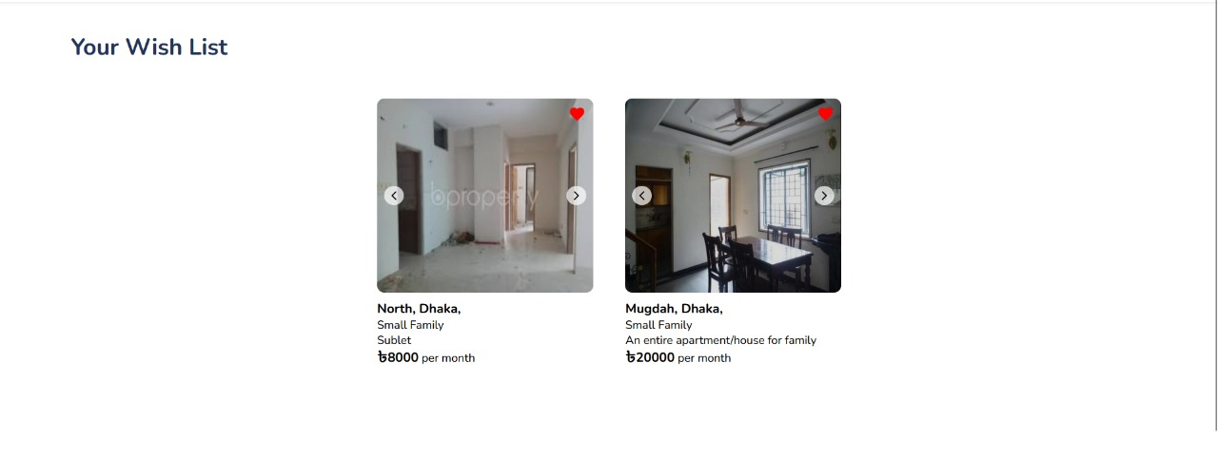
FUNCTIONALITY

Slide 14
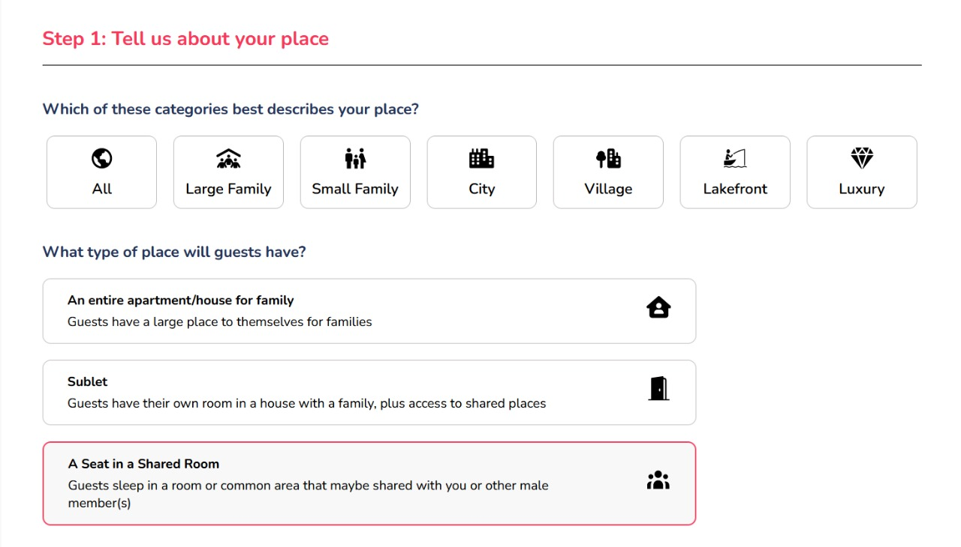
FUNCTIONALITY

Slide 15
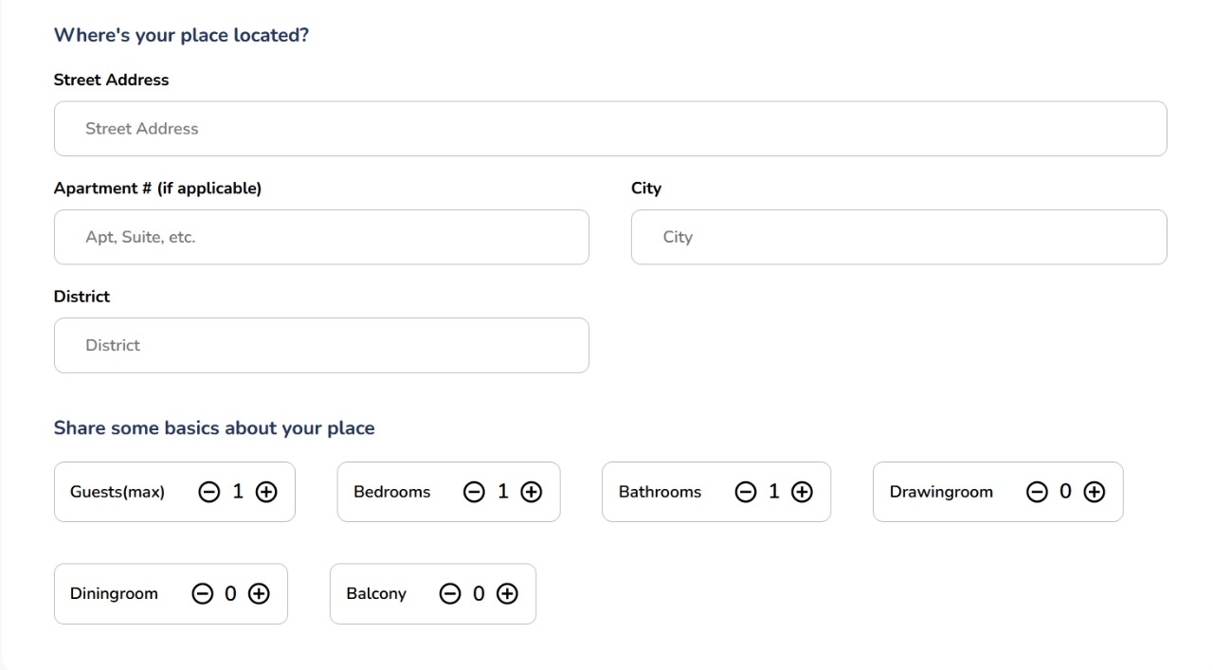
FUNCTIONALITY

Slide 16
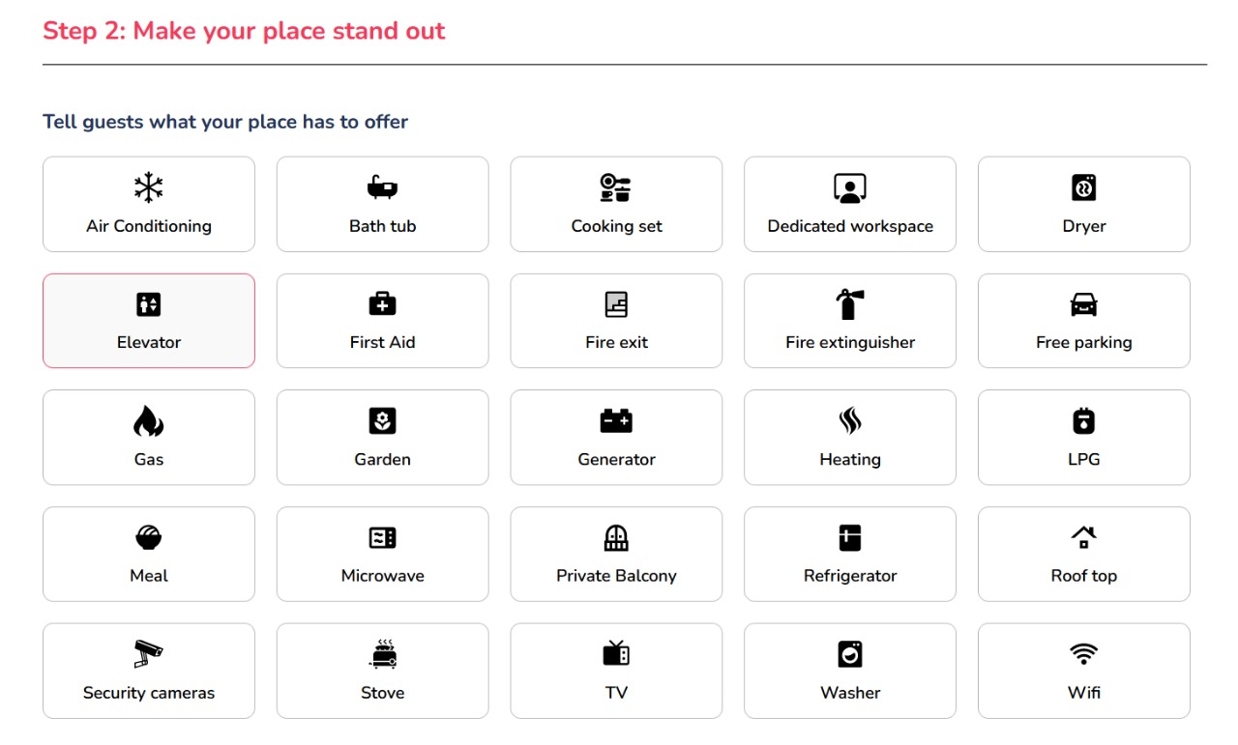
FUNCTIONALITY

Slide 17
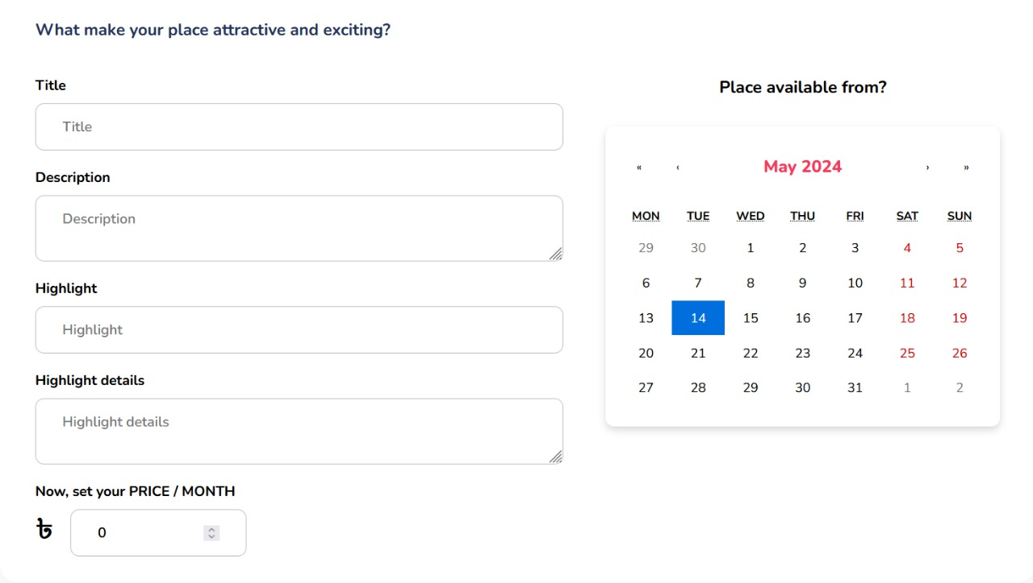
FUNCTIONALITY

Slide 18
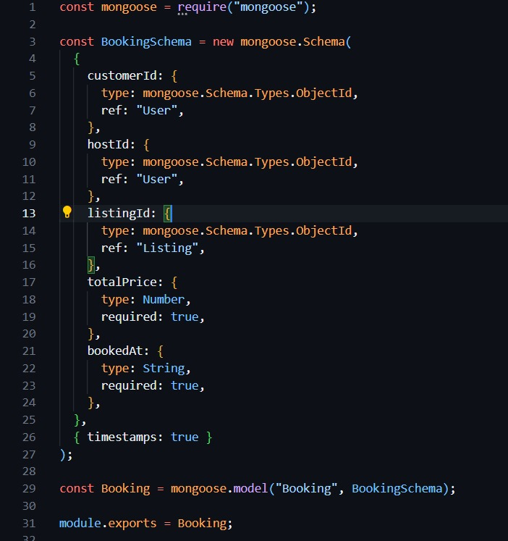
DATABASE

Slide 19
THANK YOU
SO MUCH

